Slide 1
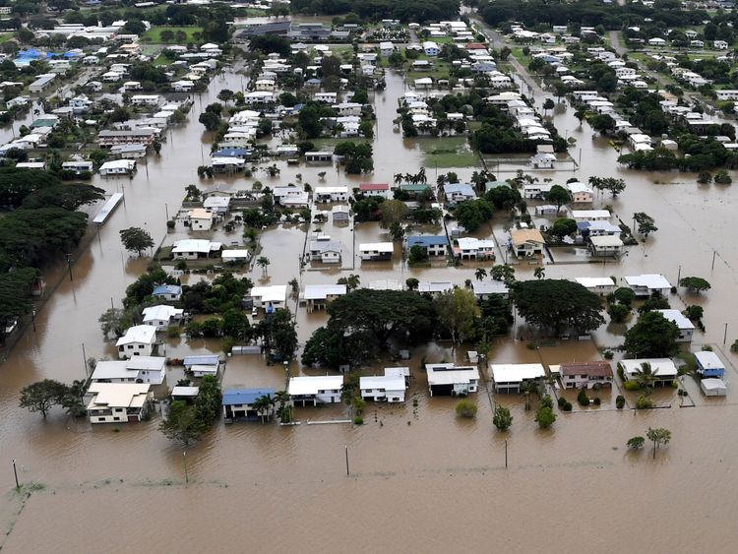
Flood monitro

Slide 2
contents
Problem definition
Why flood monitro?
Introduction
Literature survey
Objective
Flood monitro
Block diagram
Circuit diagram
Hardware
Software
CIRCUIT SETUP
BLYNK APP
ResultS
advantage
Future Scope
conclusion
references

Slide 3
Problem definition
Flooding may occur as an overflow of water from water bodies, such as river, lake, or ocean, resulting in some of that water escaping its usual boundaries.
Excessive rain, a ruptured dam or levee, rapid melting of snow or ice.
Floods are responsible for the loss of precious lives and destruction of large amounts of property every year, especially in the poor and developing countries, where people facing threats.

Slide 4
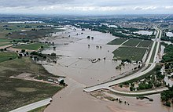
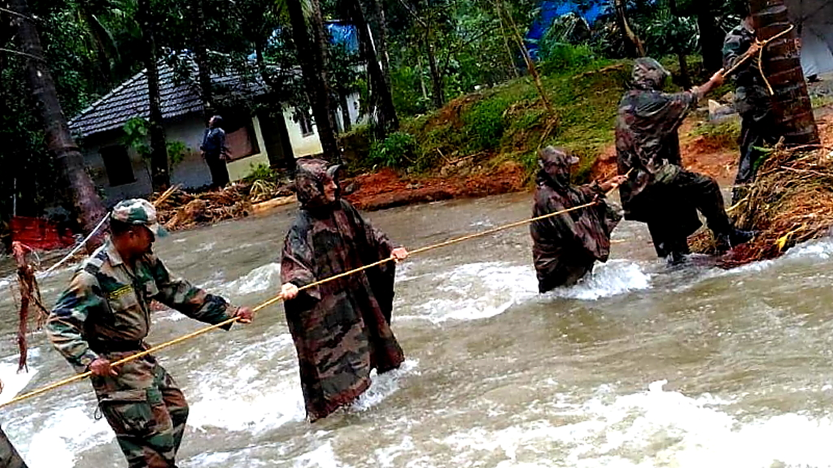
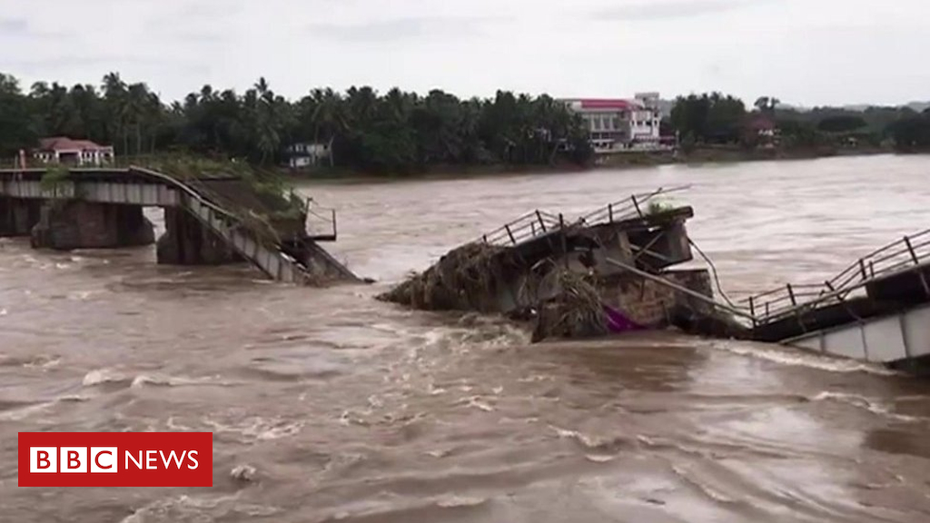



Slide 5

Why flood monitro?
From 8 August 2018, Unprecedented summer monsoon rainfall throughout June, July and August has left floods across the state.
Worst flood in Kerala after the “great flood of 99” in 1924.
Over 483 peoples loss their liVes and 15 are missing.
All 14 districts of the state were placed on red alert.
Thirty-five out of the fifty-four dams within the state were opened for the first time in history.

Slide 6

INTRODUCTION
Flood is one of the major problems in India.
This may be attributed to climate change which causes high rate of rainfall, placing many cities at increased risk of flooding .
During flood the peoples assets like roads, houses, farms etc. are destroyed and many people become homeless.

Slide 7
Literature survey
1. Disaster Flood Alert System Using Ultrasonic Sensor(2013)
Ultrasonic transducers are used to find out the water level of the flood.
Information from ultrasonic sensor is given to the controller and GSM .
It continuously send the messages towards control room about the level of flood when water level will change.

Slide 8
Literature survey
2. Flood Alert System by using Weather Forecasting Data and Wireless Sensor Network(2015)
The wireless sensor network is playing important role to transmission and monitoring the data.
Collect rainfall data and flow of water level data.
Sends flood notification messages to the base station of that area for necessary action.

Slide 9
Literature survey
3. A Wireless Smart Sensor Network for Flood Management Optimization(2017)
The system is based on Wireless Smart Sensor Network (WSSN) for early flood warning.
WSSN performs pre-processing procedures at sensor level before sending the data to a base data analyzing station.
Pre-analyzing is performed and reports are sent to the base station only if the analysis gave a high risk level.

Slide 10
Literature survey
4. Flood Monitoring and Early Warning System Using Ultrasonic Sensor(2017)
This study focuses only on the water level detection and early warning system.
The novelty of this work falls under the utilization of the Arduino, ultrasonic sensors, GSM module and SMS early warning system.
Inquiry system is also included in this study.

Slide 11
Literature survey
The Development of Smart Flood Monitoring System using Ultrasonic sensor with Blynk Applications(2017)
A smart flood monitoring system using Blynk platform.
Data detected from the ultrasonic sensors will be sent to the Blynk application via wireless connection.
Alert the person in charge of the control unit.

Slide 12

objective
To implement a smart flood monitoring system.
To identify the flood affected areas earlier.
To help people by identifying the nearby safest places.

Slide 13

Flood monitro
a smart flood monitoring system.
Three different sensors are used for data collection.
Nodemcu process the signal from the sensors.
NodeMCU as a mean communication protocol for transmission.
GSM module send alert messages to the concern agencies, local officials and the local communities.

Slide 14
Flood monitro
Flow Sensor
Measure the flow rate
Humidity Sensor
Measure temp & humidity
Ultrasonic Sensor
Detect the water level

Slide 15
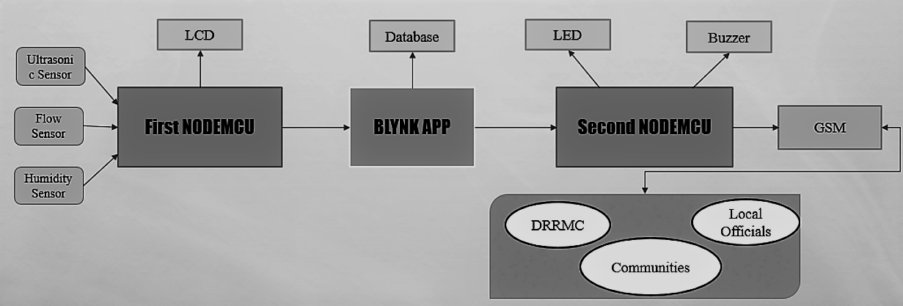
block diagram

Slide 16
working
It is based on two NodeMCU development board integrated using Blynk application (IOS or android).
The first NodeMCU is placed at the flood area(transmitter), while the second NodeMCU acts as the control unit(receiver).
Ultrasonic sensor detect the water level and the flow sensor measures the rate of flow of water and display it on the LCD.

Slide 17
working
The data detected from the sensors will be sent to the Blynk application via wireless connection.
To alert the person in charge of the control unit, the data then will be send to second NodeMCU via Blynk bridge.
At the same time, the data is stored in a CSV database.

Slide 18
working
Both application and second NodeMCU located at the control center to inform the person in charge to take further action when water level rises.
once the level reaches warning or critical level which triggers the buzzer and LED.

Slide 19
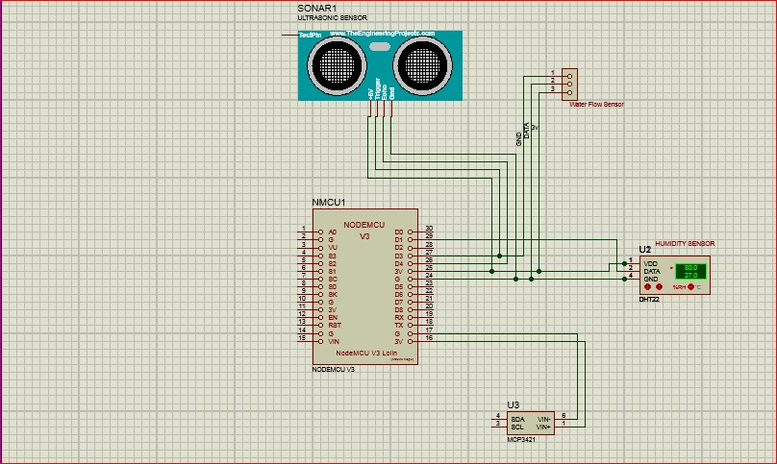
Circuit diagram
Flood monitoring system
(transmitter section)

Slide 20
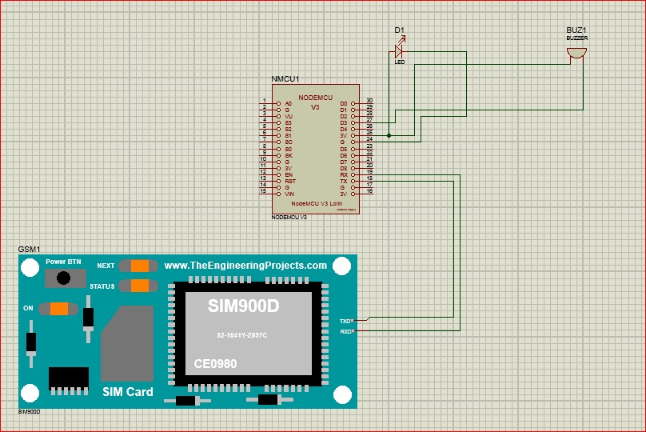
Circuit diagram
early warning system
(receiver section)

Slide 21
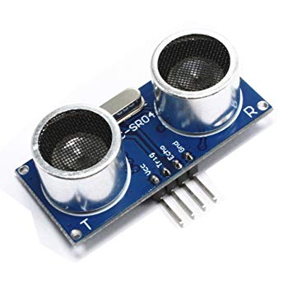
hardware
HCSR04 ULTRASONIC SENSOR
An ultrasonic sensor measures the distance of respective object by sending the sound wave of specific frequency.
The sound wave is reflected after the collision with respective object and this wave is received by the ultrasonic receiver.
Distance is measured by calculating the sending and receiving time of this sound wave.

Slide 22
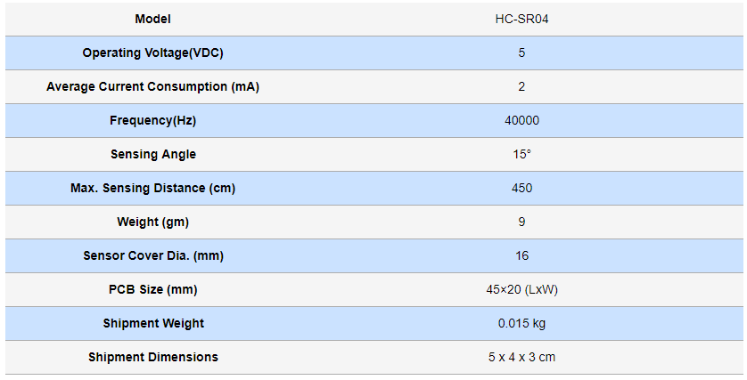
Hardware
Specifications

Slide 23
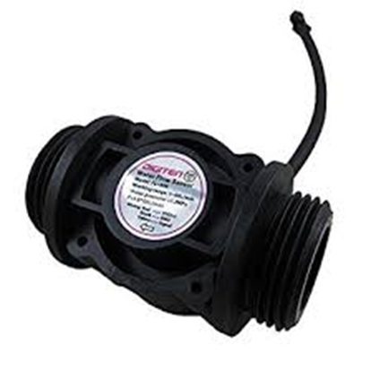
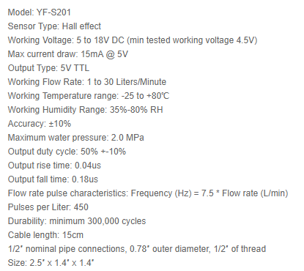
Hardware
ii) YF-S201 FLOW SENSOR
It is the volume of water that moves over a designated point over a fixed period of time.
The flow of a stream increasing during rainstorms and decreasing during dry periods.

Slide 24
Hardware
iii) dht11
DHT11 is a humidity and temperature sensor with calibrated digital signal output.
This sensor includes a resistive type humidity measurement component and an NTC temperature measurement component.
It offering excellent quality, fast response, anti-interference ability and cost effectiveness.

Slide 25
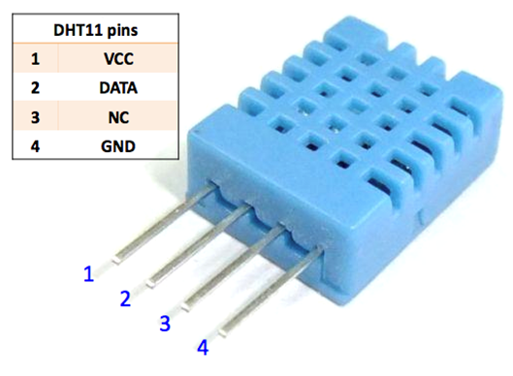
Hardware
specifications
Operating Voltage: 3.5V to 5.5V
Operating current: 0.3mA (measuring)
Output: Serial data
Temperature Range: 0°C to 50°C
Humidity Range: 20% to 90%
Accuracy: ±1°C and ±1%

Slide 26
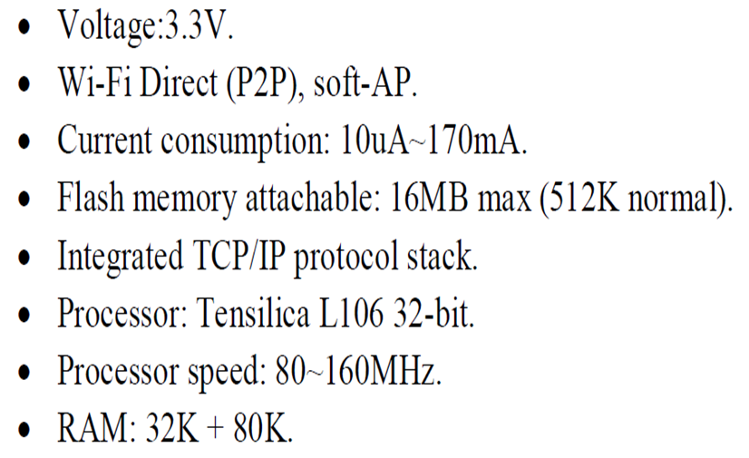
Hardware
iv) ESP8266 NodeMCU
Node Microcontroller Unit is the central coordinator of the sensors and the actuators.
This microcontroller has built-in support for Wi-Fi connectivity.

Slide 27
Hardware
Pin Configuration

Slide 28
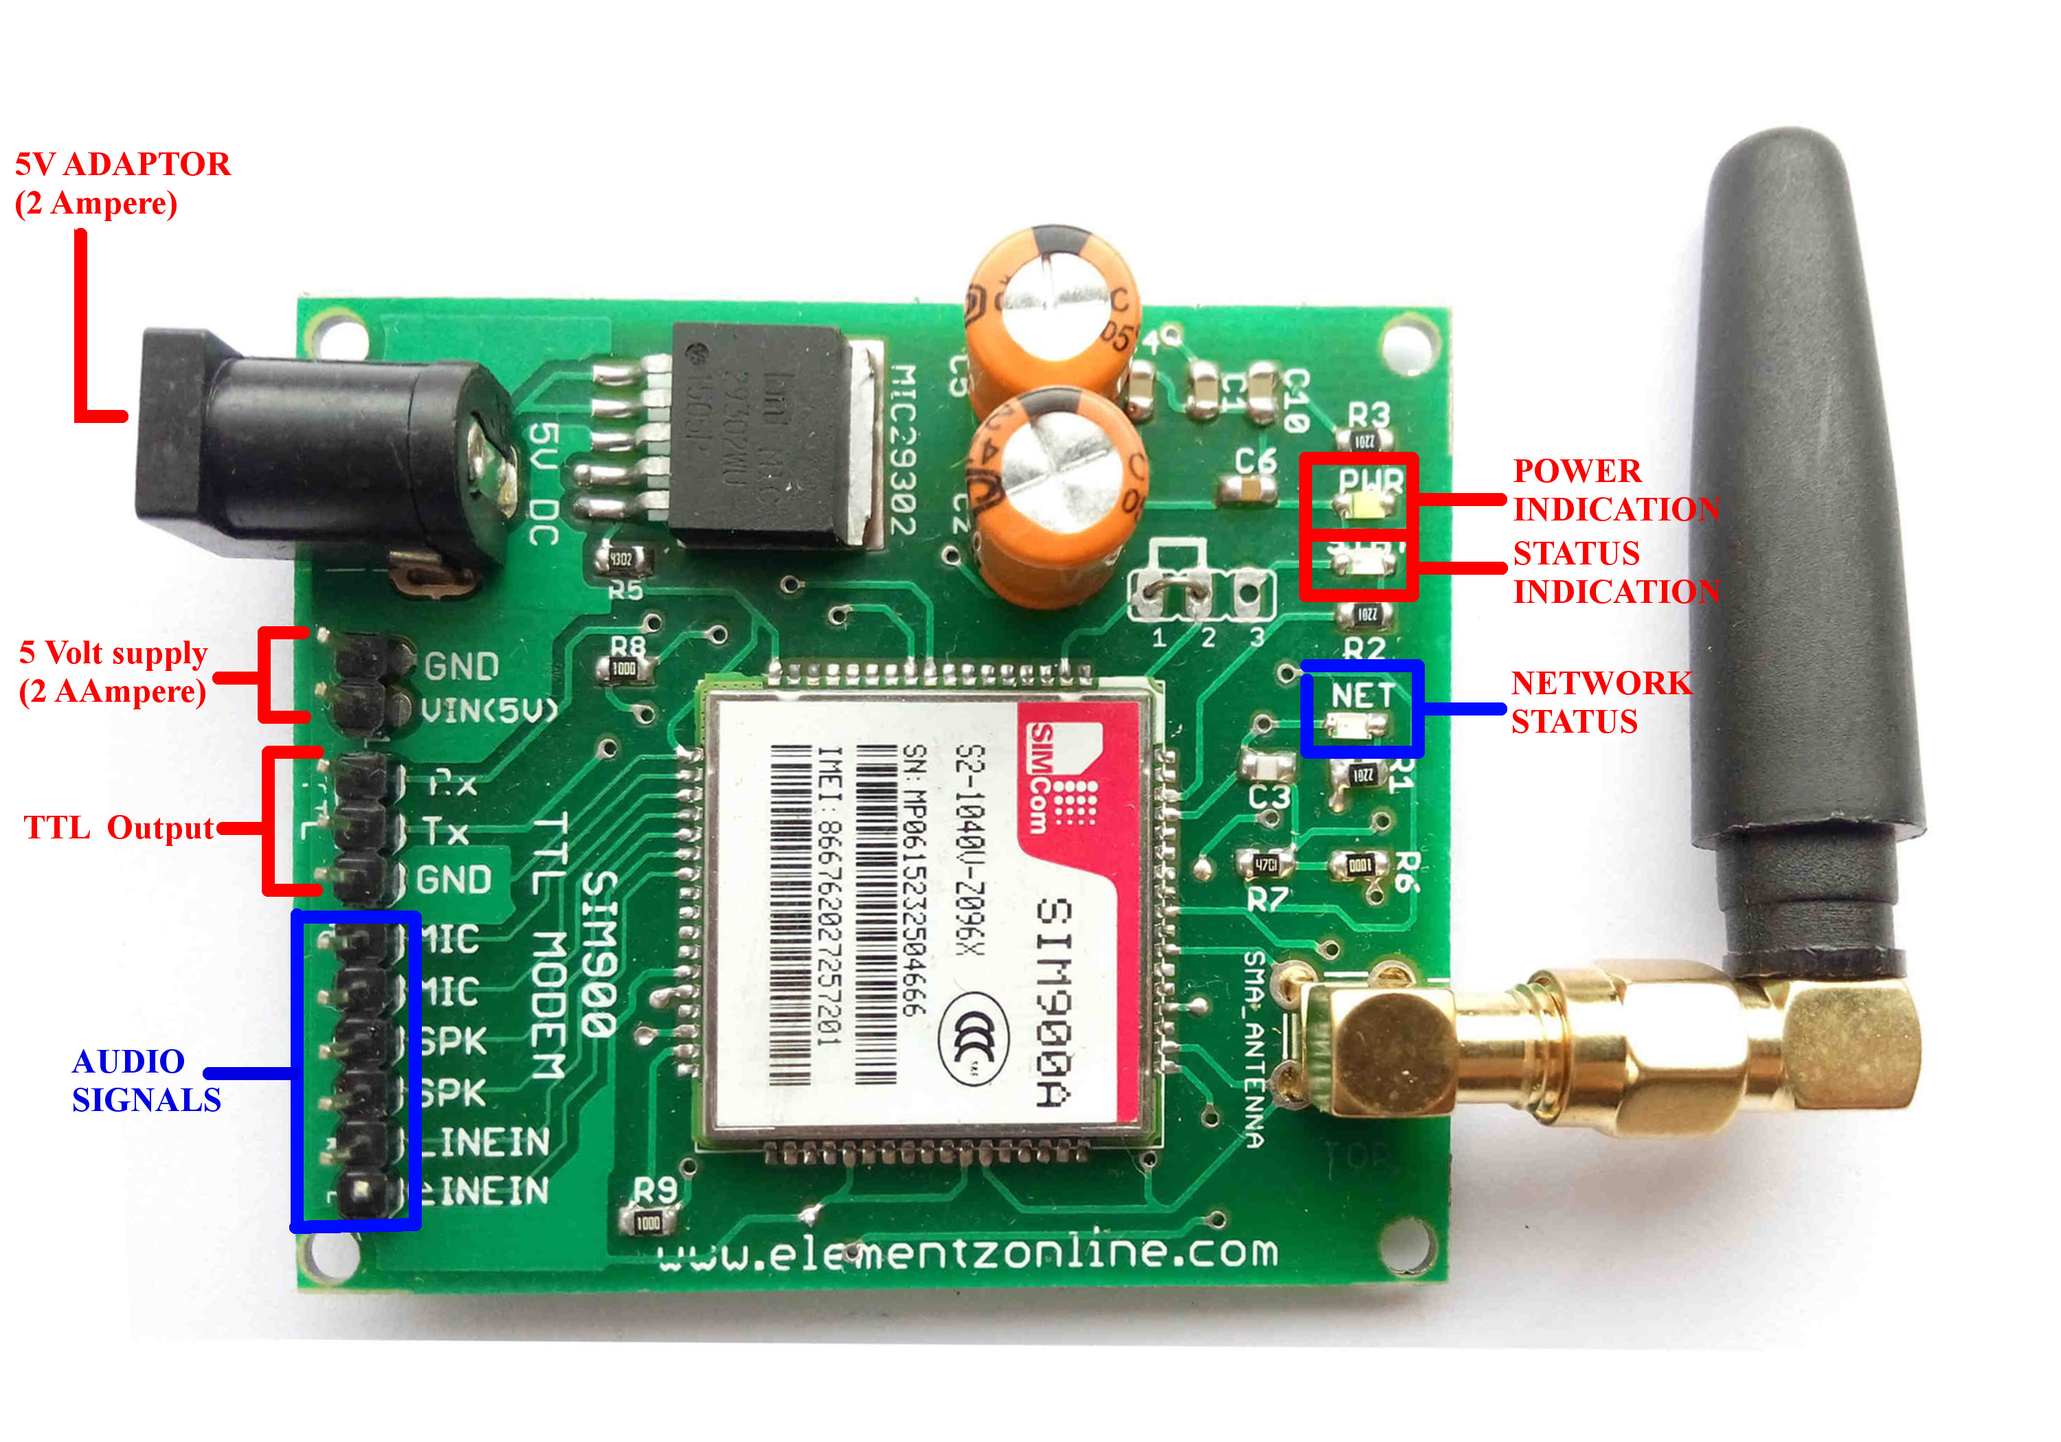
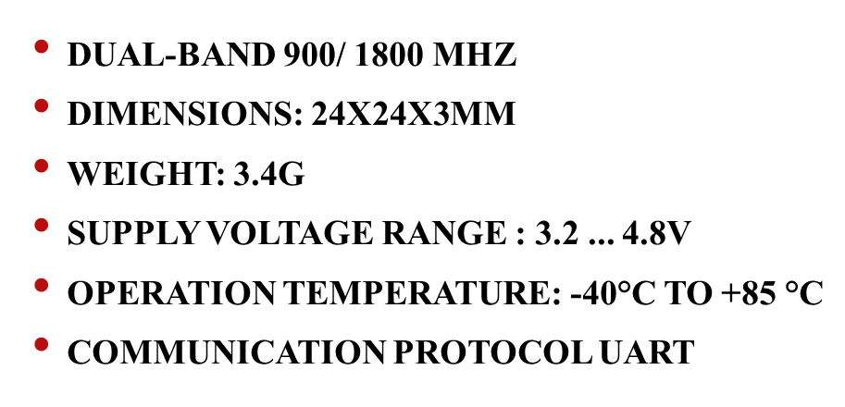
Hardware
v) SIM 900A - GSM/GPRS Module
A GSM module or a GPRS module is a circuit used to establish communication between a mobile device or a computing machine and a GSM or GPRS system.
Specifications

Slide 29
software
Blynk Application, Blynk bridge and Database
Blynk is a iot platform with IOS and Android application to control Arduino, Raspberry Pi, Nodemcu with access of Internet.
It's a digital dashboard where it can build a graphic interface for the user by simply drag and drop the widgets.
Blynk bridge is another way to communicate between two ESP8266 modules .

Slide 30
software
It can interconnect all its projects using the cloud Blynk server as a live central transaction manager.
At the same time, the database also was created in this Blynk application for the purpose of recording the flood level sensed by the sensors.

Slide 31
software
ii. Arduino IDE(C++)
ardunio (Ide) is a cross-platform application (for Windows, macOS, Linux) that is written in the programming language Java, c, c++.
It is used to write and upload programs to Arduino compatible boards.
NodeMCU is programmed using IDE.
The Arduino platform is programmed based on the high-level programming language C ++.

Slide 32
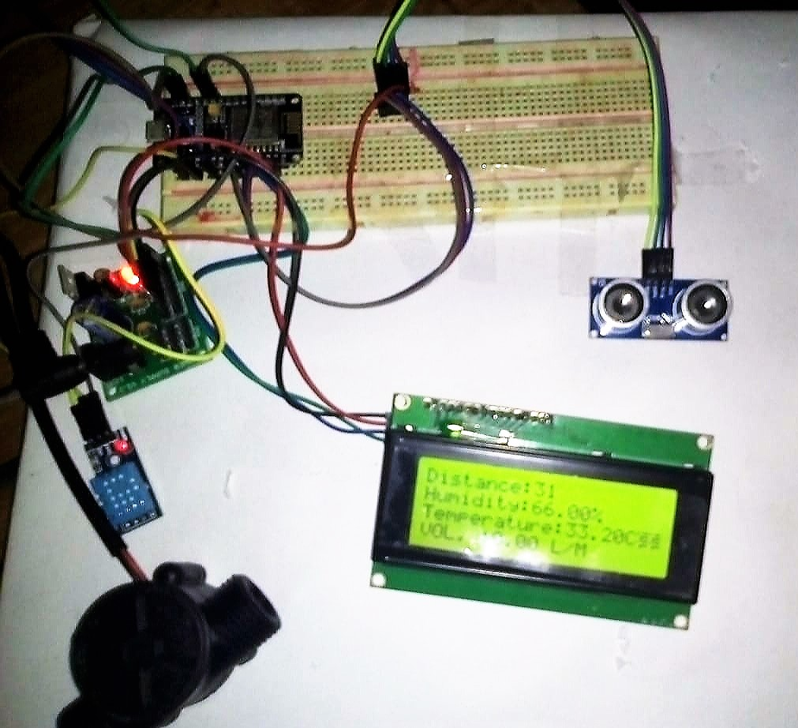
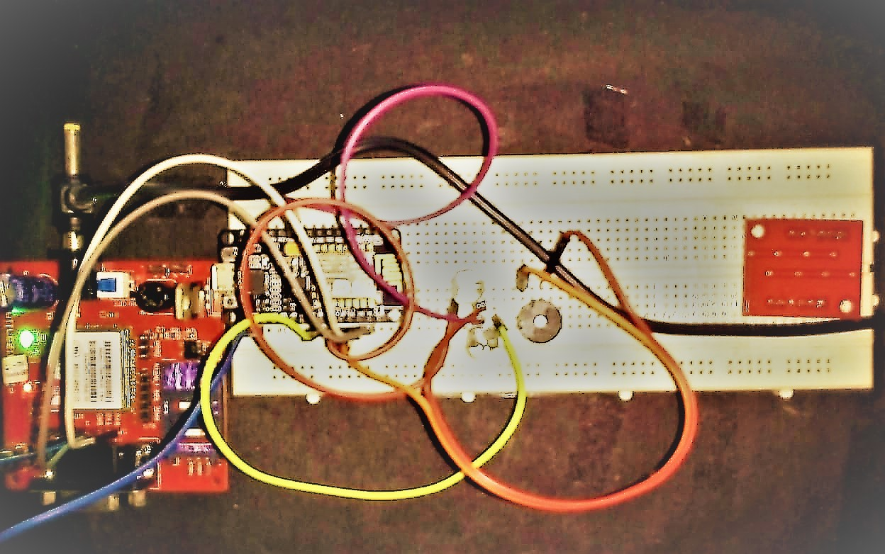
Circuit setup
Transmitter section
Receiver section

Slide 33
Blynk app
First, designing the application where the designer can select the widget for their apps.
Through the app sensor readings will display.
There will be LCD to display the level indicator (warning and critical level).
Besides that, the LED will lights up according to the current level.
Lastly the history graph will track the flood’s level and save it into database.

Slide 34
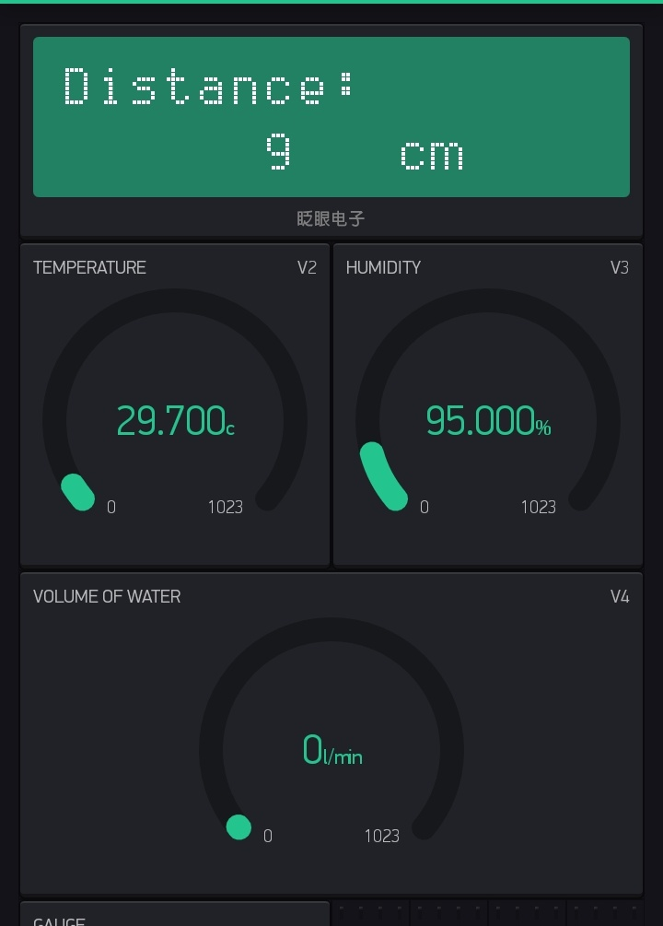
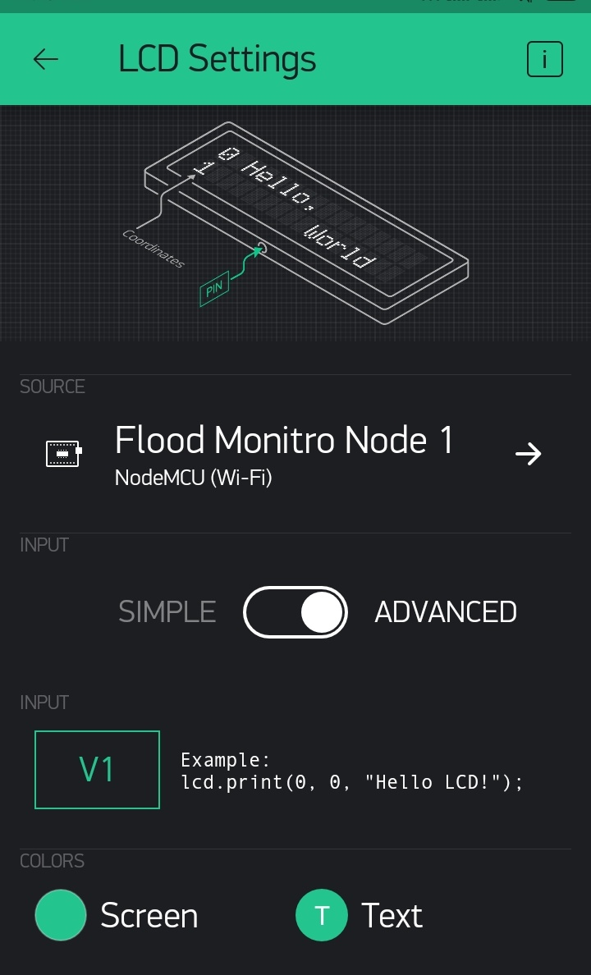
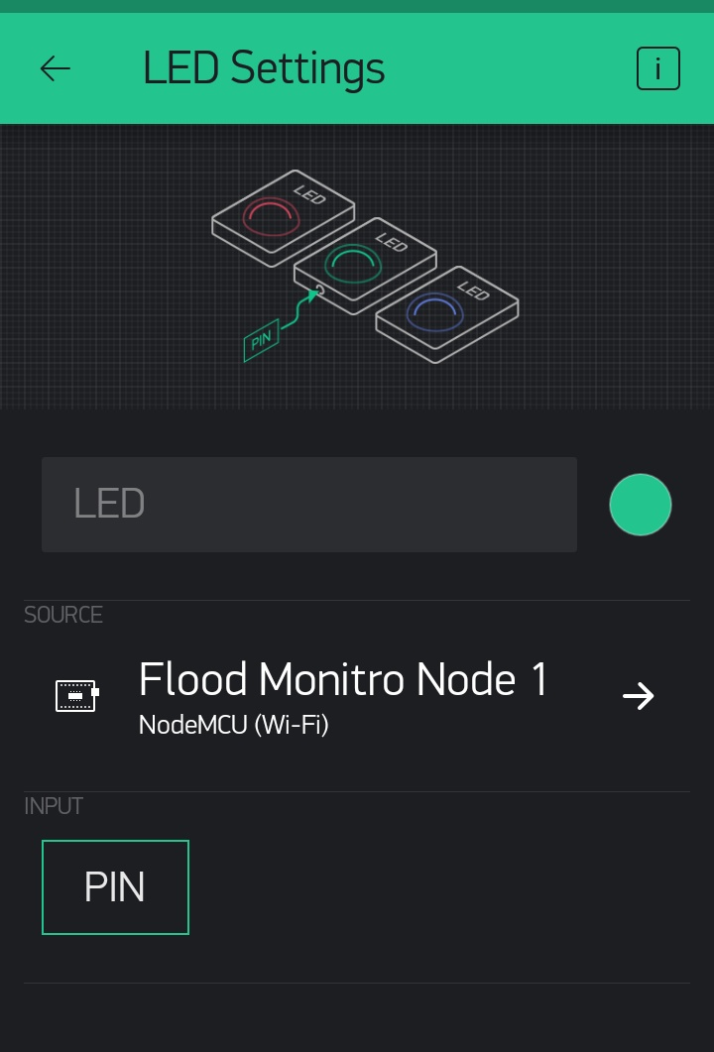
Blynk app
Fig. shows the layout designs of blynk app.

Slide 35
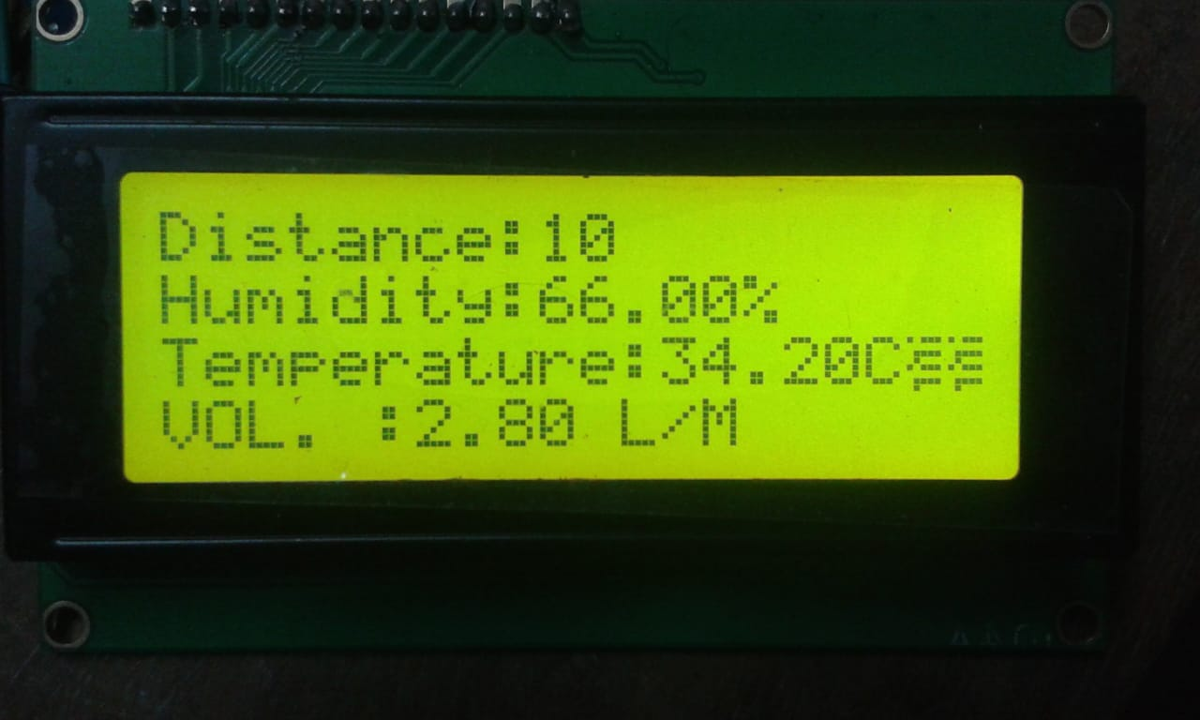
results
After the project has been completed, played out a model.
test the ease of use and dependability of the developed prototype.
tested the developed prototype through a temporary basin to test the level of water.
The test decided whether it meets the necessities of the client.
The sensor data is displayed in the lcd at transmitter.

Slide 36
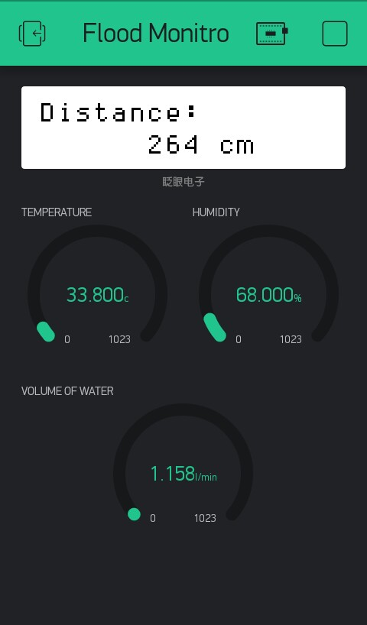
Results
The wireless communication and transmission of data between first NodeMCU to second NodeMCU are successfully achieved.
The data sensed were displays through the Blynk application and it can be recorded in the database develop in this Blynk application.
Figure shows the reading of data sense from the three sensor from the first NodeMCU in Blynk application platform.

Slide 37
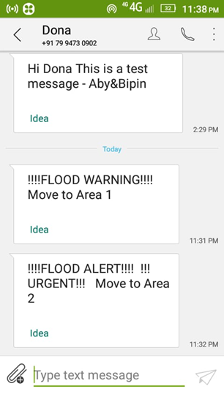
Results
Flow is measured in l/m.
Water level is measured in cm.
Two threshold levels are set for flood alert.
When the flow exceeds 3l/m warning message sent.
After receiving warning message, people should move to area1 which is the nearby safest place.

Slide 38
Results
When the water level become less than 20cm , flood alert message sent to communities.
Flood alert message is the critical message.
After receiving alert message, people should move to area2 which is farther than area1.
HUMIDITY AND TEMPERATURE READINGS ARE RELEVANT INFORMATIONS CAN BE USED FOR WEATHER FORECASTING AND FLOOD DTECTION.

Slide 39
advantages
the system uses wireless connection, so that the system can be more efficient, and can be applied in real time monitoring.
it has the advantages of iot.
Blynk is simple & easy to use.
It provides cool GUI.
NodeMCU has almost everything that an Uno has to offer, high flash memory, clock speed and inbuilt wi-fi module.
Less expensive components.

Slide 40
Future Scope
The system can be integrated with modern space technologies and Geographical Information Systems(GIS).
This will enable the system to determine the flood affected areas by exploiting the collected flood-related data and different image processing techniques such as data merging, segmentation and classification to enhance the authorities to make better decisions on managing flood.
It can be modified to detect tsunami in sea.

Slide 41
conclusion
This project is based on the development of a smart flood monitoring system using ultrasonic sensor with NodeMCU and Blynk application .
also involving buzzer, LED and LCD display.
By using the Blynk application, the information can easily be accessed by the person-in-charge.

Slide 42
Conclusion
Transmission of flood information begins at first NodeMcu then transmitted to the second NodeMCU using the Blynk application.
Early notification on flood monitoring can be seen through the LED and buzzer.
disseminating information to the concern stakeholders for a possible flood event by SMS notification system wherein an automatic communication between the system and the local communities and other concern agencies.

Slide 43
references
Disaster Flood Alert System Using Ultrasonic Sensor(2013)
A Simple Flood Forecasting Scheme Using Wireless Sensor Networks(2012)
Flood Alert System by using Weather Forecasting Data and Wireless Sensor Network(2015)
A Wireless Smart Sensor Network for Flood Management Optimization(2017)
Flood Monitoring and Early Warning System Using Ultrasonic Sensor(2017)

Slide 44
References
6. The Development of Smart Flood Monitoring System using Ultrasonic sensor with Blynk Applications(2017)
7. A Review On IoT Based Smart Home Using Blynk Framework (2017)
8. IoT-based Home Appliances Control System Using NodeMCU and Blynk Server (2018)
9. Development of Detection and Flood Monitoring Via Blynk Apps (2018)

Slide 45

THANK YOU!!!

